Slide 1

Healthcare Operations & Financial Performance: What Does the Data Reveal?
Hospital management needs a clear view of patient demand, hospital stay patterns, billing performance, and data-quality issues to support better operational and financial decisions.
Dataset Scale
Scope of Analysis
Audience & Purpose
55,500 patient records analyzed across a 5-year period (May 2019 – May 2024)
Patient demand, billing patterns, Length of Stay, and data quality — examined across 15 variables
Senior management decision-support: operational planning, financial oversight, and data governance
This presentation communicates findings in plain business language. All statistics are drawn directly from the dataset. No causal claims are made where the data does not support them.

Slide 2

Data Used & How We Analyzed It
Analytical Workflow
Dataset
01
55,500 patient records across 15 variables, spanning May 2019 to May 2024. No missing values were identified in the raw data.
Clean
Remove duplicates, confirm completeness, flag anomalies
Data Quality
02
534 exact duplicate records were identified and removed prior to analysis, ensuring each patient encounter is counted once.
Prepare
Standardize formats, engineer derived variables
Preparation
03
Dates and categories were standardized. Three derived metrics were created: Length of Stay, Age Group, and Stay Category.
Compare
Segment by condition, admission type, and billing
04
Visualize & Interpret
Surface patterns and translate findings into management language

Slide 3
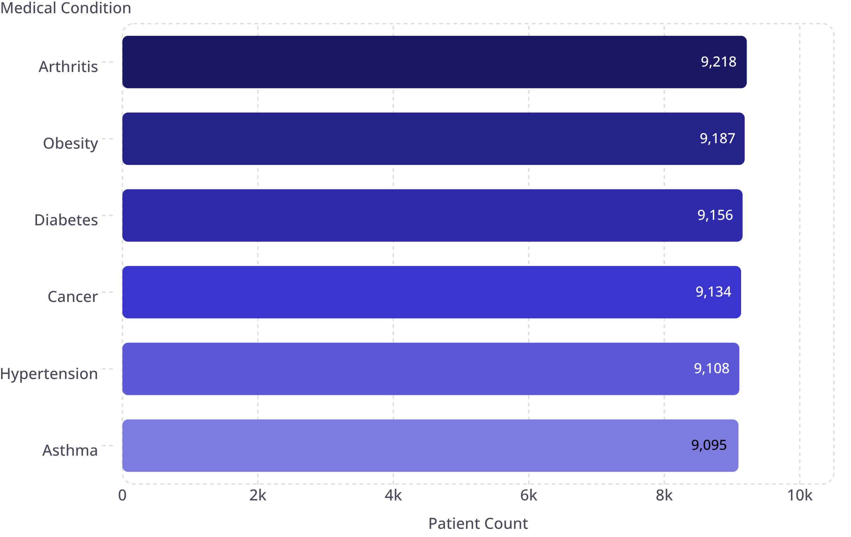
Patient Demand Is Broadly Distributed Across All Conditions
Highest Volume
Arthritis — 9,218 records
Lowest Volume
Asthma — 9,095 records
Total Range
Only 123 patients — a 1.3% difference across all six conditions
No single medical condition dominates patient volume. Demand is effectively uniform, which has direct implications for staffing and resource allocation across service lines.

Slide 4
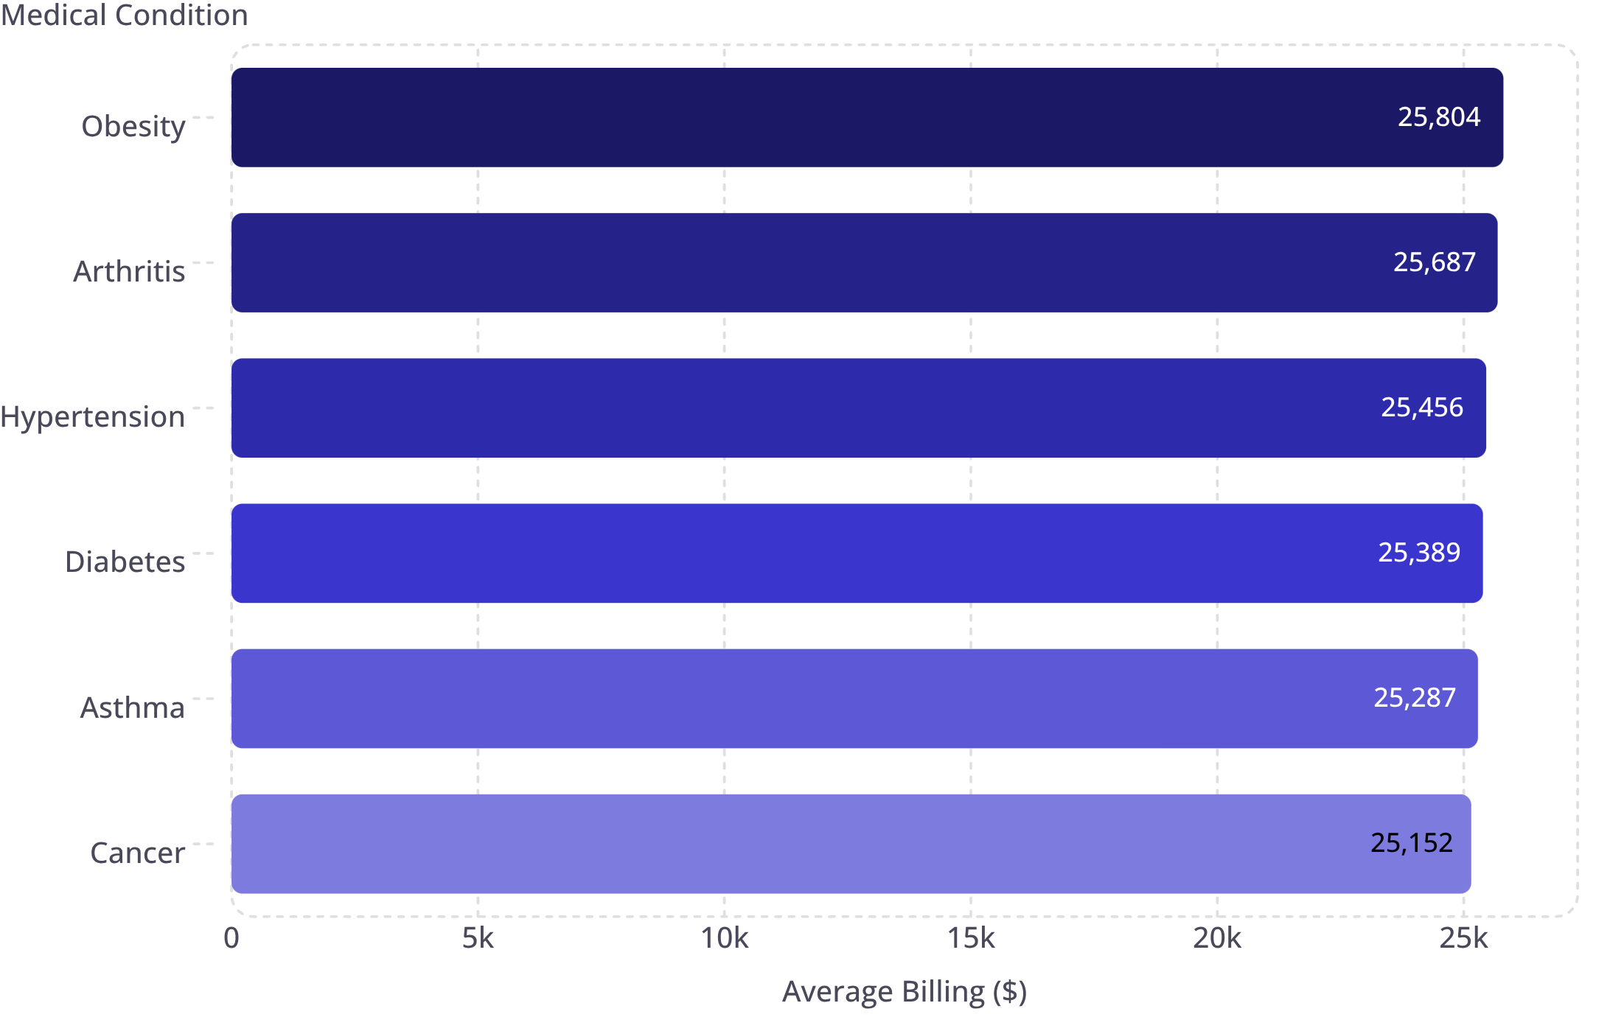
Average Billing Is Consistent Across Medical Conditions
Highest Avg. Billing
Obesity — $25,804
Lowest Avg. Billing
Cancer — $25,152
Total Range
Only $652 — a 2.6% difference across all conditions
Financial impact is stable regardless of condition mix. Revenue projections are unlikely to shift materially based on changes in the condition distribution of admitted patients.

Slide 5
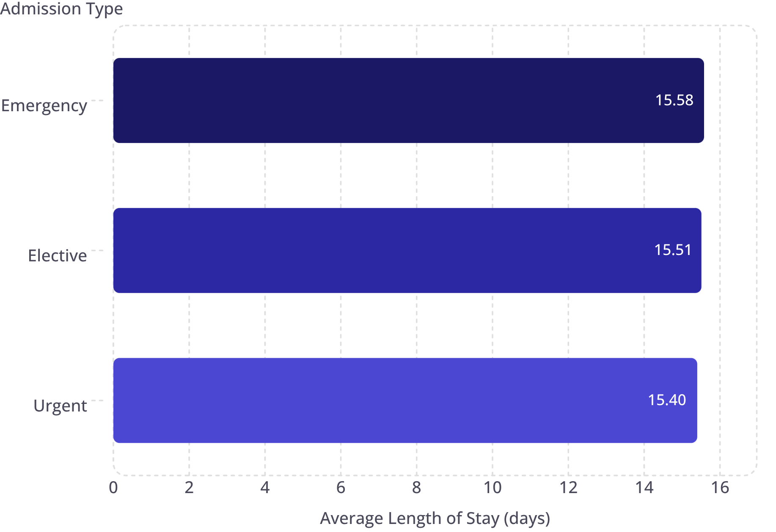


Unexpected Finding: Admission Type Does Not Meaningfully Change Length of Stay
Initial Expectation
Emergency admissions were expected to have noticeably longer hospital stays than elective or urgent cases.
What the Data Showed
All three admission types cluster tightly between 15.40 and 15.58 days. Admission type alone is not a strong differentiator of Length of Stay.
Key Limitation
The dataset lacks clinical variables — severity, procedures, and complications — that are likely the true drivers of Length of Stay. Further investigation requires richer data.
The difference between the longest and shortest average Length of Stay is 0.18 days — approximately 4.3 hours. This is not a meaningful operational distinction.

Slide 6

Critical Data Quality Issue: 106 Negative Billing Records Require Validation
106
1
Current Risk
2
Immediate Action Required
The 106 negative billing records cannot be reliably used for financial reporting, revenue analysis, or operational decision-making in their current state.
Records Flagged
Finance and Data/IT teams must validate and correct these records before any billing-based analysis is published or acted upon by management.
Negative billing amounts identified in the dataset
These records represent a data integrity risk that must be resolved before any billing-based decisions are made.
3
Path Forward
Once resolved, the billing dataset will be suitable for resource planning, condition-level financial analysis, and insurance provider benchmarking.
Immediate action required: Do not use billing totals or averages in financial reports until the 106 negative records are reviewed and corrected.

Slide 7

Three Actions for Management
1
2
3
Strengthen Billing Data Validation — Highest Priority
Investigate Real Drivers of Length of Stay — High Priority
Combine Volume & Billing for Resource Planning — Medium Priority
Review the 106 negative billing records and introduce automated validation checks before financial reporting. Establish a recurring data-quality audit cycle to prevent recurrence.
Owner: Finance + Data/IT
Admission type alone does not explain Length of Stay variation. Analyze against clinical and patient-level factors (severity, procedures, complications). Identify and collect additional variables where gaps exist.
Owner: Operations + Clinical + Analytics
Patient demand and billing are both stable across conditions — use this as a baseline to monitor shifts over time. Track by medical condition and insurance provider to inform staffing and capacity decisions.
Owner: Operations + Finance + Clinical Management
Success Measures
Billing-data correction rate
Average Length of Stay trends
Bed utilization
Patient volume by condition
Billing by condition & provider

